Slide 1
GALA Guide Milestone1 Report
Team Members
Hanran Zho Haodong He
Jianzheng Huang Qiwen Xiao
Lianji Bai

Slide 2
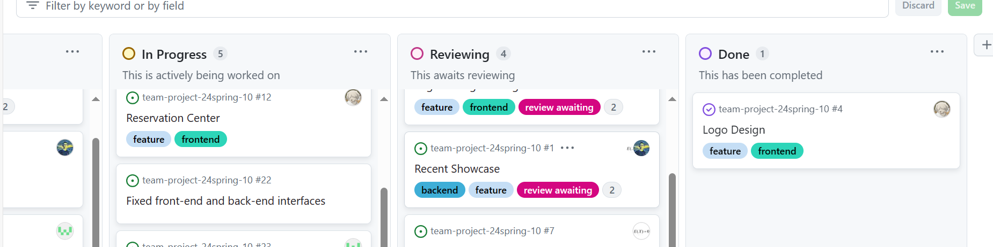
Milestone Review：Project Schedule
Scrum Dev
Task Status
Code Review
Quality Check

Slide 3
Challenges:
Integration
Issues
Solvements
Data Schema Inconsistency
Doc not clearly
Attack Possibility
Use API Tools
Project doc construction
Schema Validation

Slide 4
Challenges:
Coding Style
Issues
Solvements
Component coupling
Code format
AI Usage
Assigned Tasks
Coding Check
Standardized mark

Slide 5
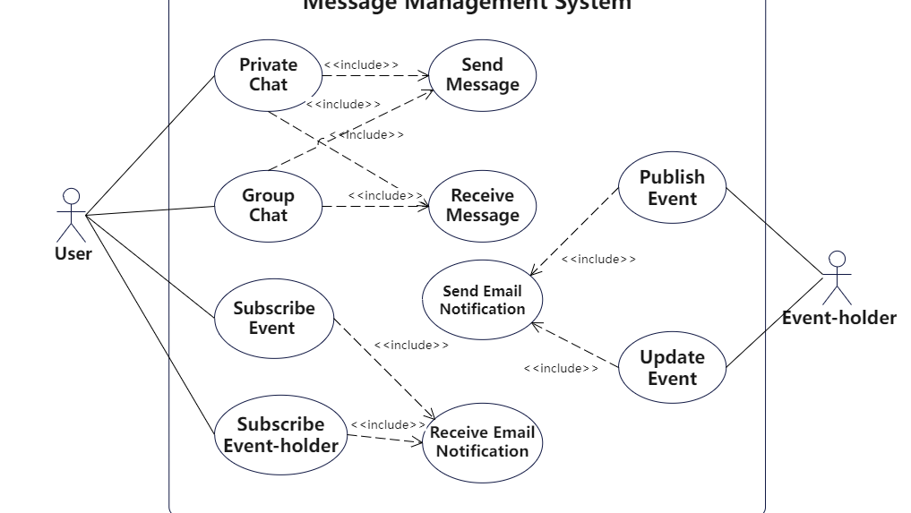
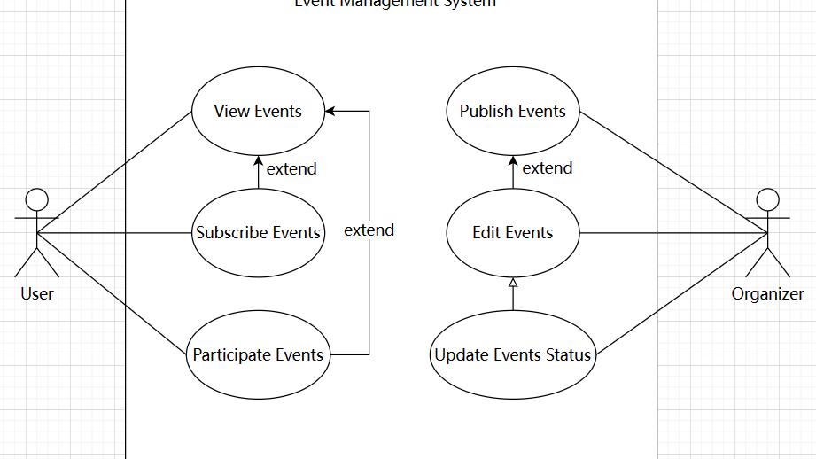
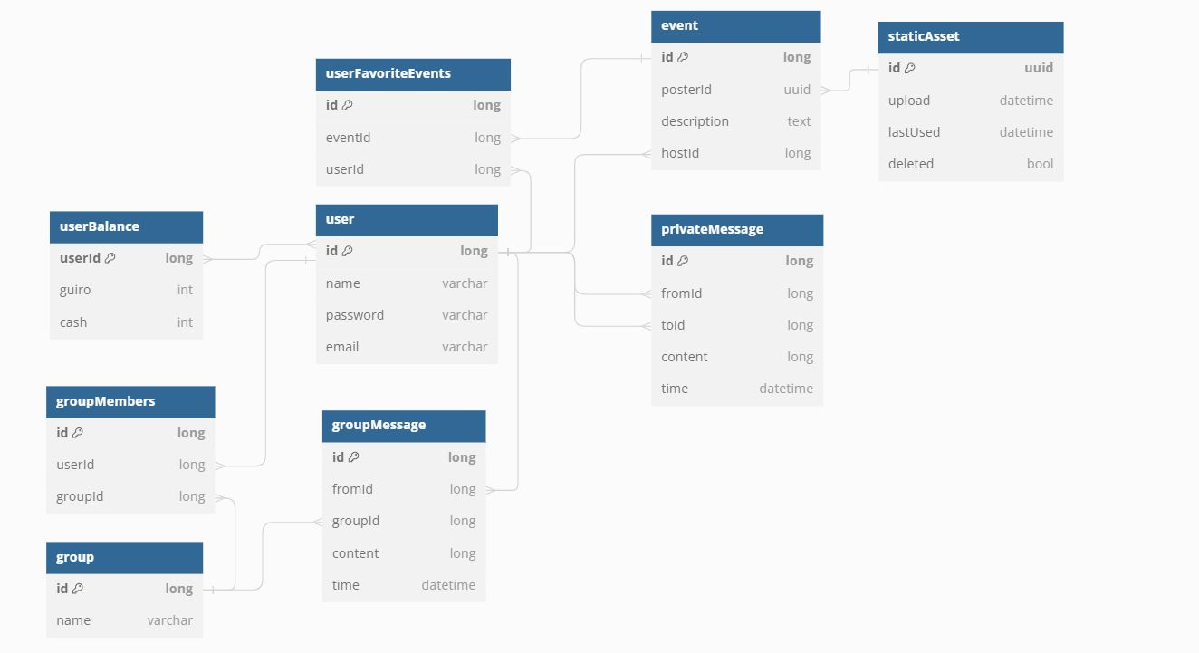
Project Design: Architecture

Slide 6

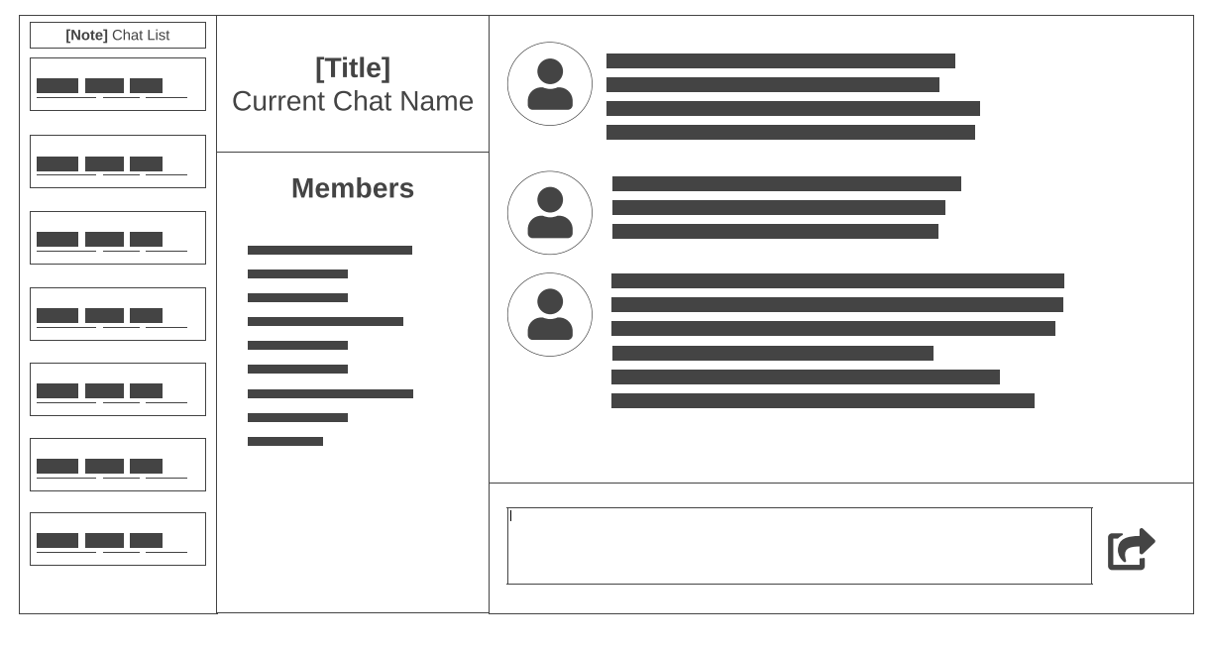
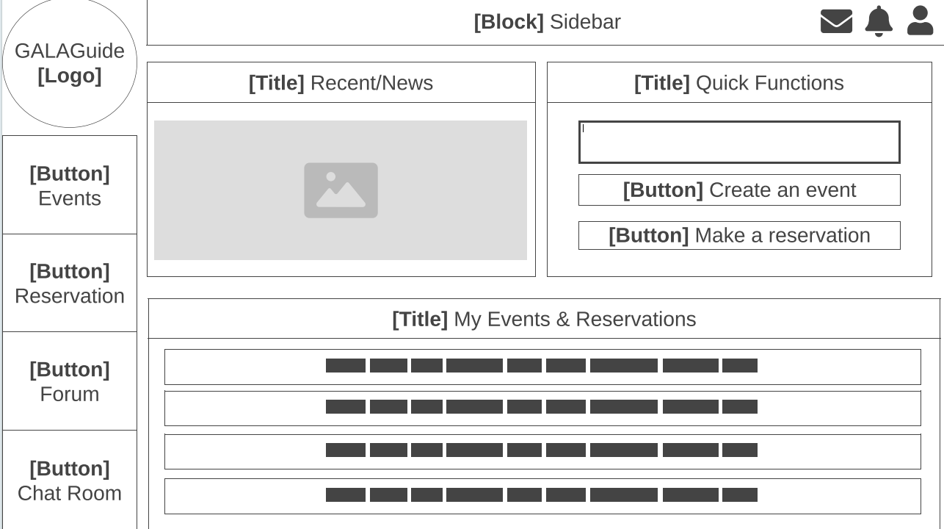
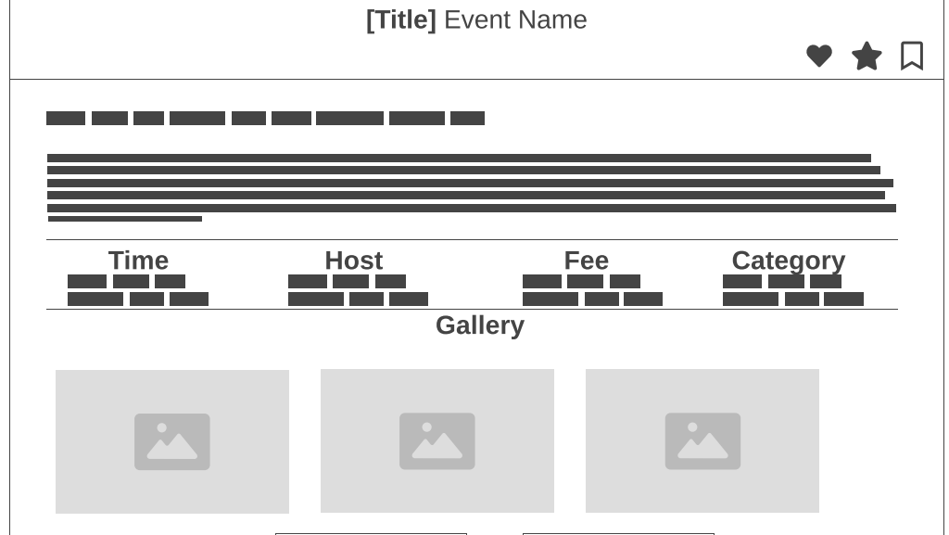
coupling
Project Design: UI

Slide 7
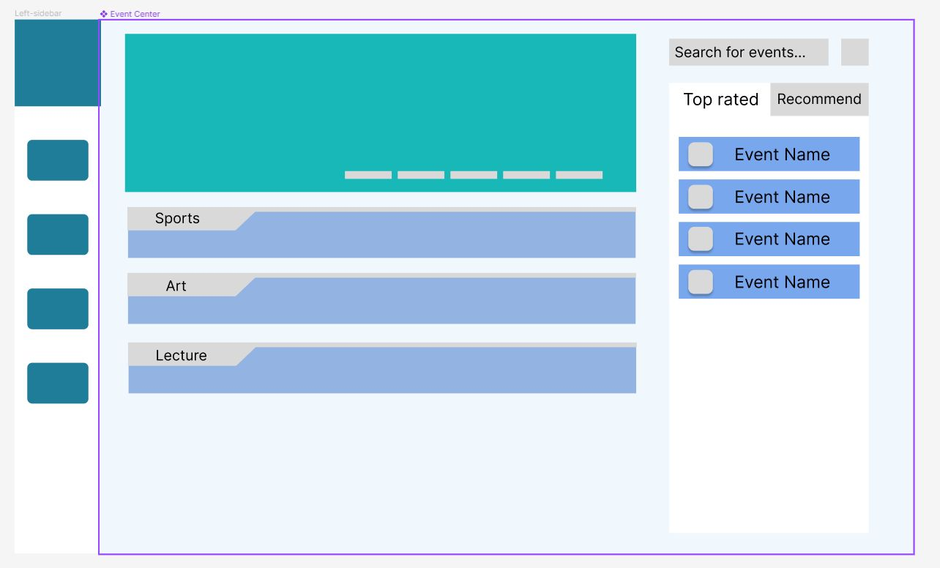
Project Design: Color & Shape
Eye-catching
Rounded and sharp
Balanced color
Accessible reading

Slide 8
Project Progress
01
Demo
02
Github
03
Contribution

